Slide 1
Automatic Music Transcription
By Khoi Nguyen

Slide 2
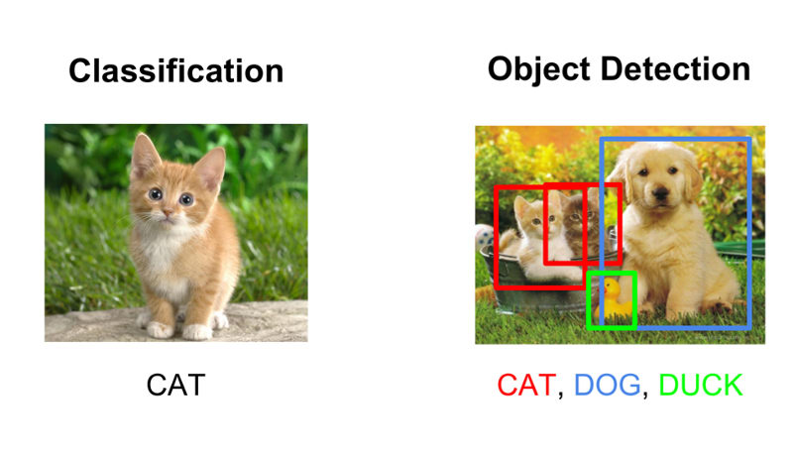
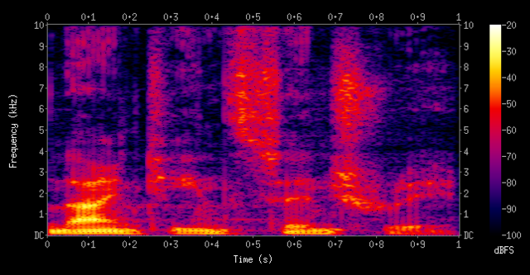
Spectrograms
Any audio can be converted into a spectrogram image
Machine learning models can classify features of an image

Slide 3
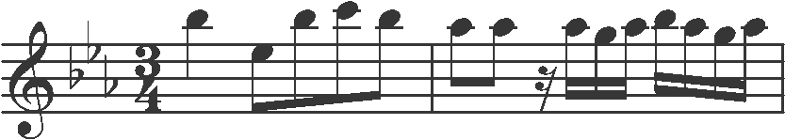
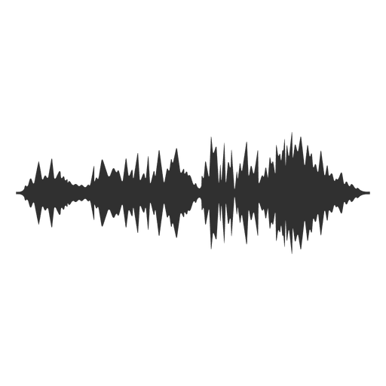
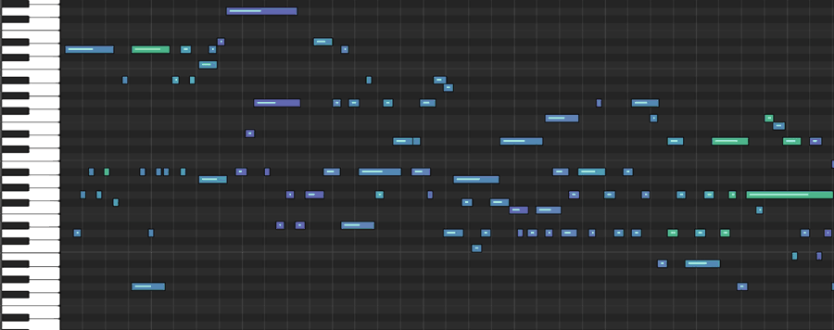
Automatic Music Transcription
Audio to MIDI or sheet music

Slide 4
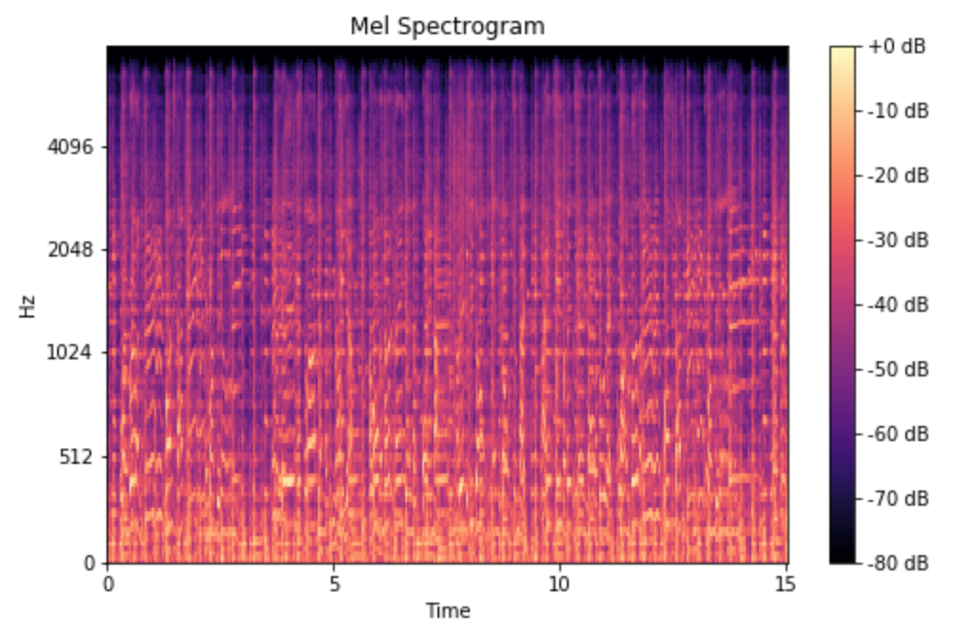
Mel Spectrograms
Use Mel Spectrograms
Convert frequency to log scale, since humans don’t perceive frequencies on a linear scale
Convert color dimension from amplitude to decibels

Slide 5

Deep Learning: Convolutional Neural Network

Slide 6
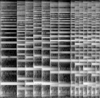

Deep Learning: Convolutional Neural Network
Original Size
128
128
CNN Output Size
1
128
Height:
128
64
32
16
8
4
2
1

Slide 7

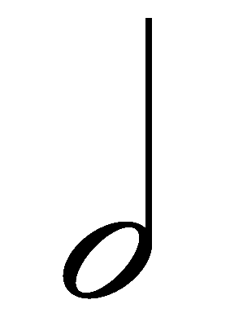
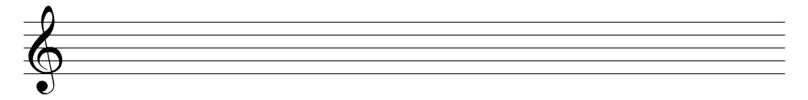

Deep Learning: Recurrent Neural Network
128
Parameter
-18.36
-563.73
56.19
-366.70
837.59
-561.42
820.41
-758.38
72.37
-227.12
Deep Learning: Connectionist Temporal
Classification Decoder

Slide 8
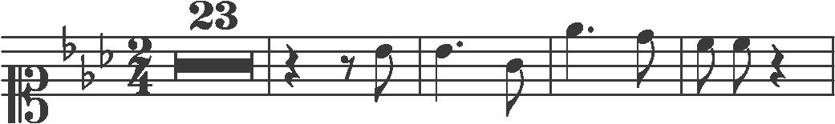
PrIMuS Dataset
87678 Monophonic real-music incipits: semantic notation and MIDI
clef-C1 | keySignature-EbM | timeSignature-2/4 | multirest-23 | barline | rest-quarter
rest-eighth | note-Bb4_eighth | barline | note-Bb4_quarter. | note-G4_eighth | barline
note-Eb5_quarter. | note-D5_eighth | barline | note-C5_eighth | note-C5_eighth | rest-quarter

Slide 9

Preprocess data
Remove cleft, barline, time signature, key signature
Remove ties
clef-C1 | keySignature-EbM | timeSignature-2/4 | multirest-23 | barline | rest-quarter
rest-eighth | note-Bb4_eighth | barline | note-Bb4_quarter. | note-G4_eighth | barline
note-Eb5_quarter. | note-D5_eighth | barline | note-C5_eighth | note-C5_eighth | rest-quarter

Slide 10
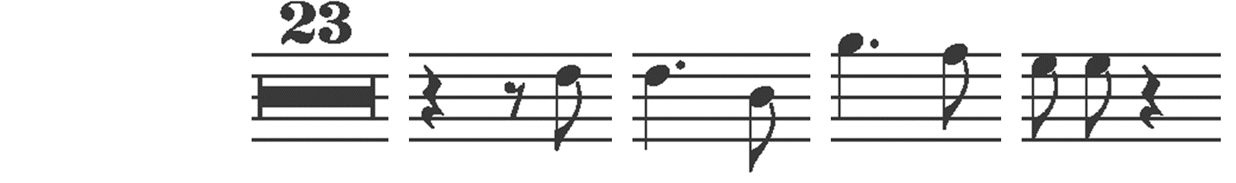
Preprocess data
Remove cleft, barline, time signature, key signature
Remove ties
 |  |  | multirest-23 |  | rest-quarter
rest-eighth | note-Bb4_eighth |  | note-Bb4_quarter. | note-G4_eighth
note-Eb5_quarter. | note-D5_eighth |  | note-C5_eighth | note-C5_eighth | rest-quarter

Slide 11

Create mappings
 |  |  | multirest-23 |  | rest-quarter
rest-eighth | note-Bb4_eighth |  | note-Bb4_quarter. | note-G4_eighth
note-Eb5_quarter. | note-D5_eighth |  | note-C5_eighth | note-C5_eighth | rest-quarter
note-G4_eighth: 3
rest-eighth: 952
multirest-23: 38
… : ….
3: note-G4_eighth
952: rest-eighth
38: multirest-23
… : ….
 |  |  | 38 |  | 61
952 | 723 |  | 687 | 3
275 | 658 |  | 163 | 163 | 61

Slide 12
Instruments
Use MIDI files to generate .wav files of 7 instruments
Violin, electric bass, piano, acoustic guitar, recorder, triangle, marimba
Test with different frequency ranges and different classes of instruments

Slide 13
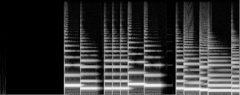
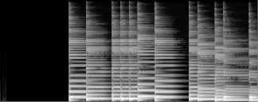
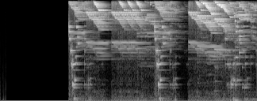
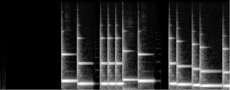
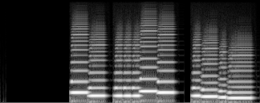
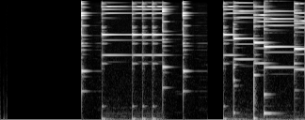
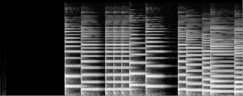
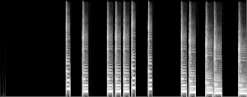
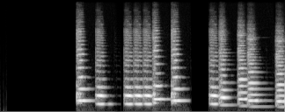
Electric Bass
Acoustic Guitar
Wind chimes
Marimba
Recorder
Triangle
Jazz Bass
Piano
Violin
Notes:
Generated from Monophonic MIDI file with instrument sound fonts

Slide 14
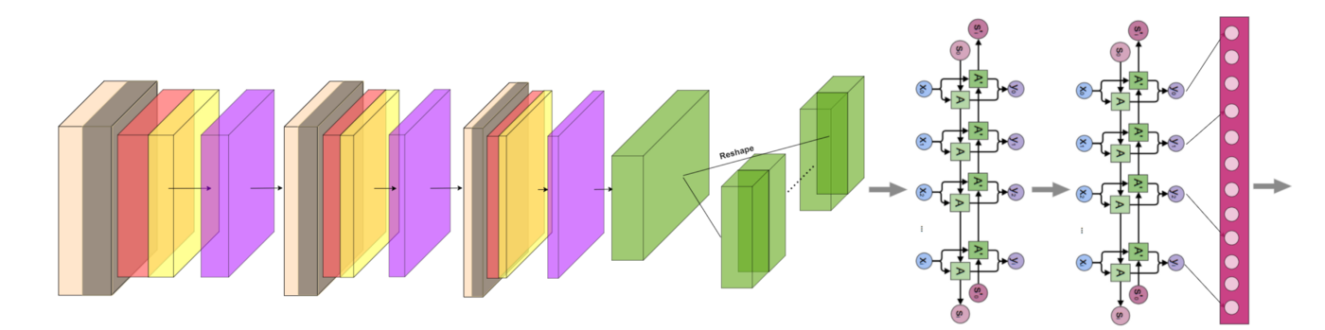
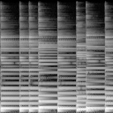
Training model
*
= numbers
CNN
RNN
x 128
CTC
128
4.57 | -0.15 | 8.31
-3.52 | 0.41 | 12.61
9.30 | -7.19 | 2.09
Parameters
52 | 226 | 111
21 | 34 | 63
Prediction
24.31 | 3.18 | 44
35.39 | 8.42 | 462.96
Loss (Error)
953 | 226 | 687
801 | 783 | 130
Target

Slide 15
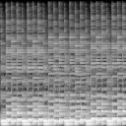
Making predictions
*
= numbers
CNN
RNN
x 128
CTC
128
-3.52 | 0.41 | 12.61
Parameters
3: note-G4_eighth
952: rest-eighth
38: multirest-23
… : ….
note-C5_eighth | note-G4_eighth | note-Ab4_eighth
84 | 3 | 245
Final output
Prediction

Slide 16
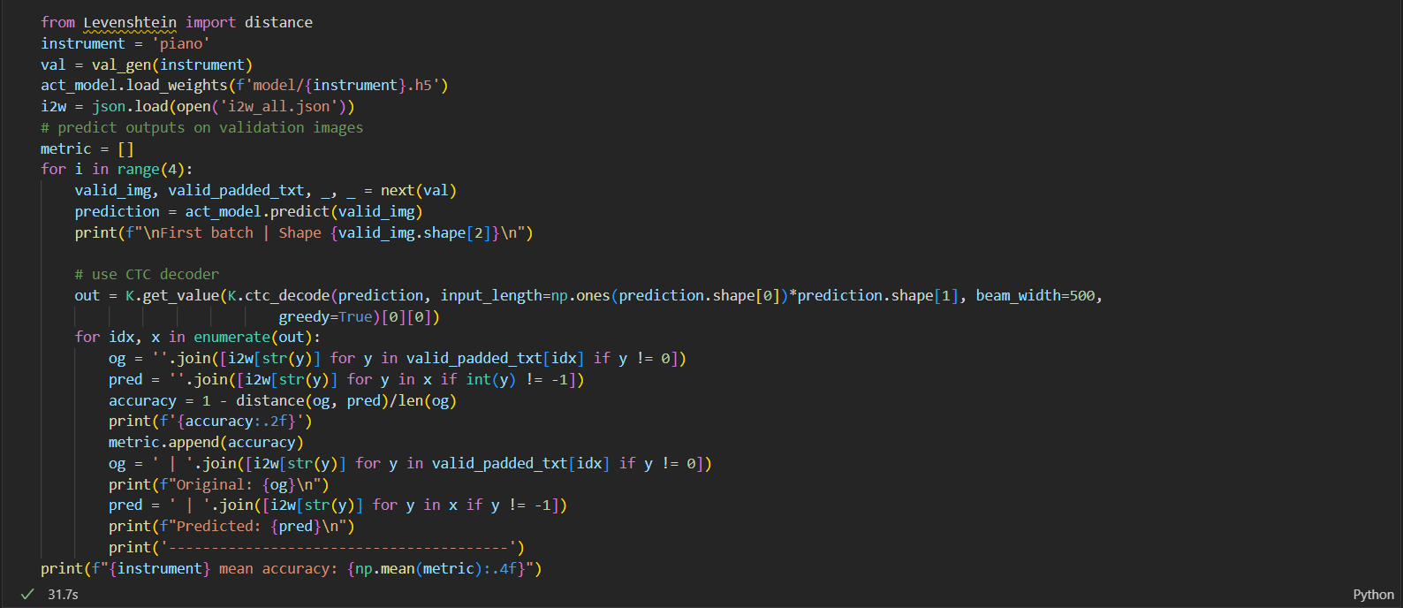
Live Demo

Slide 17
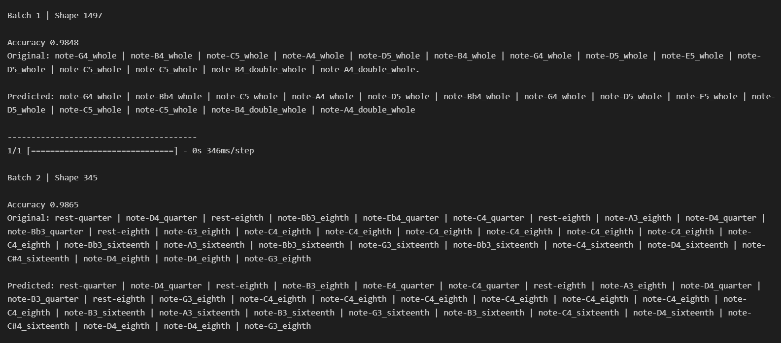
Live Demo

Slide 18
Live Demo

Slide 19
Predictions
Rest
Rest
Flat
Flat
Flat
Fermata/Note duration
Perfect transcription

Slide 20
Instrument Transcription Results
Piano
Triangle
Piano: 94.54%
Acoustic guitar: 93.73%
Marimba: 93.60%
Triangle: 90.48%
Violin: 89.41%
Recorder: 88.69%
Electric bass: 61.74%
Acoustic guitar
Violin
Electric Bass
Marimba
Recorder

Slide 21
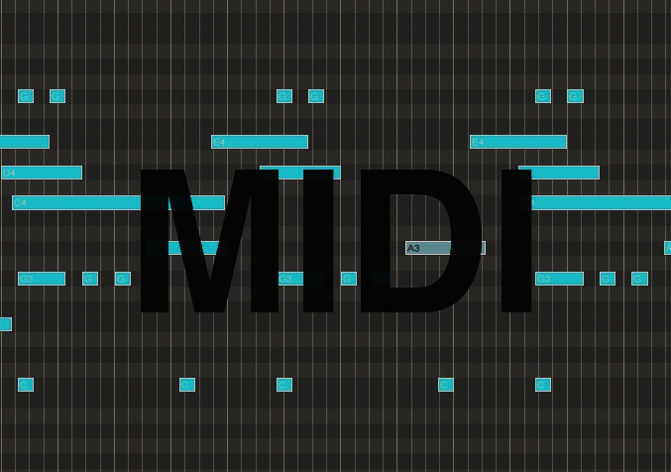
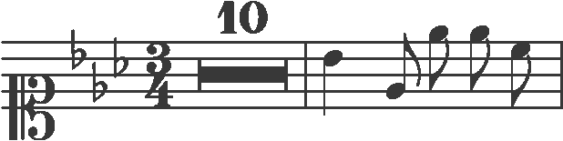
Next Step: End to End
Prediction
52 | 226 | 111
3: note-G4_eighth
952: rest-eighth
38: multirest-23
… : ….
note-C5_eighth | note-G4_eighth | note-Ab4_eighth
Final output

Slide 22
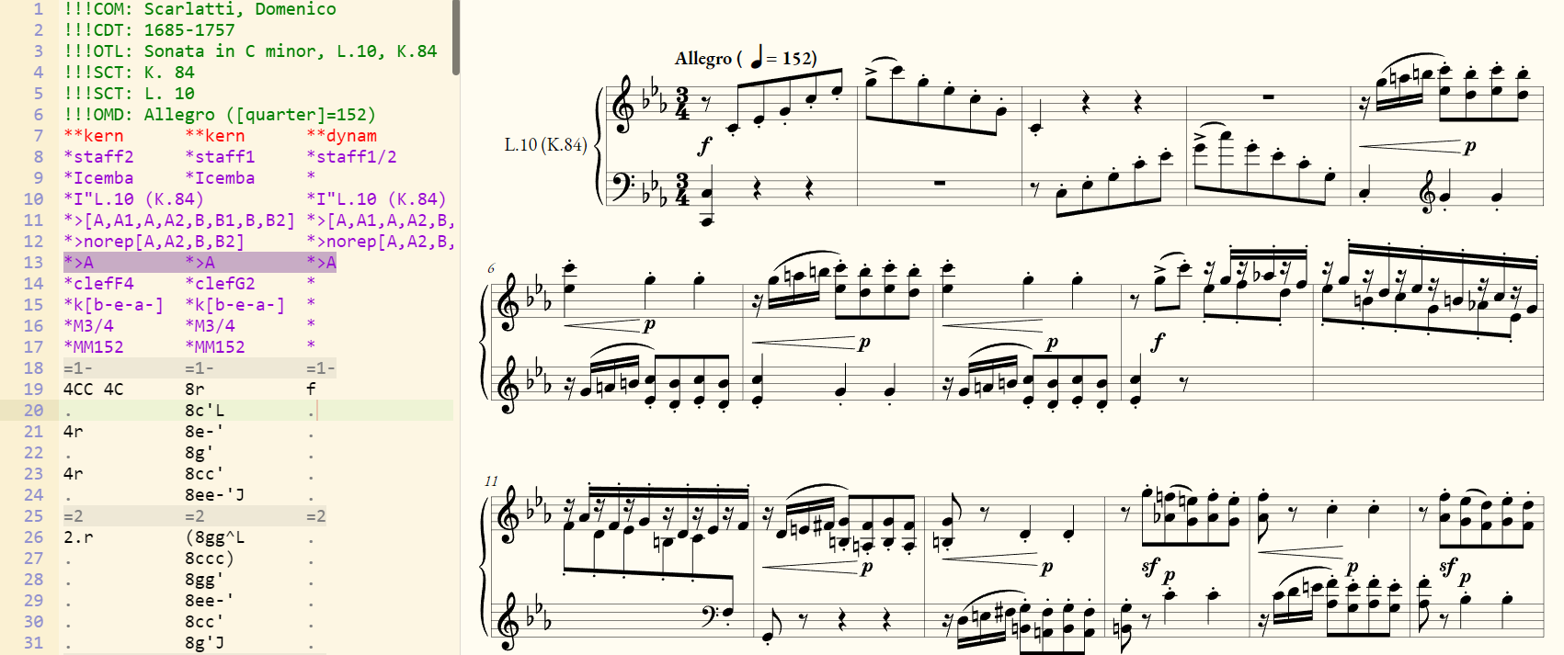
Next Step: End to End

